Slide 1
Wired LANs: Ethernet

Slide 2
IEEE STANDARDS
In 1985, the Computer Society of the IEEE started a project, called Project 802, to set standards to enable intercommunication among equipment from a variety of manufacturers.
Project 802 does not seek to replace any part of the OSI model or TCP/IP protocol suite.
Instead, Project 802 is a way of specifying functions of the physical layer and the data link layer of major LAN protocols.
The standard was adopted by the American National Standards Institute (ANSI).

Slide 3
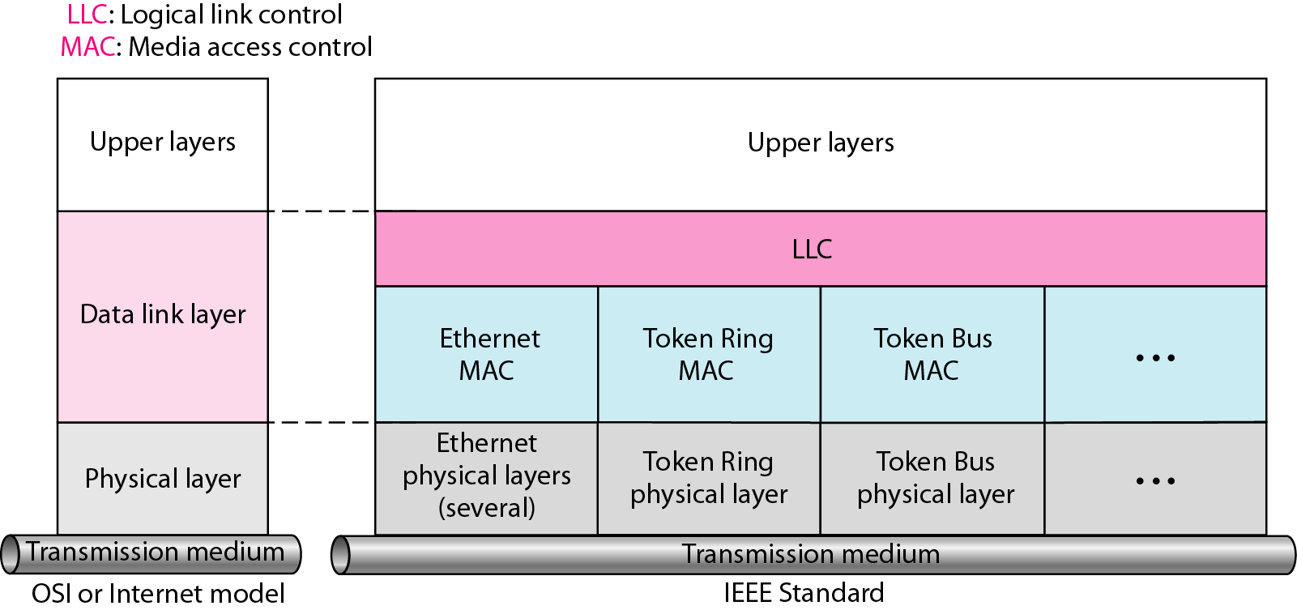
Figure: IEEE standard for LANs
Notes:
The IEEE has subdivided the data link layer into two sub-layers: logical link control (LLC) and media access control (MAC). IEEE has also created several physical layer standards for different LAN protocols.
Logical Link Control (LLC)
Earlier we discussed data link control. We said that data link control handles framing, flow control, and error control. In IEEE Project 802, flow control, error control, and part of the framing duties are collected into one sub-layer called the logical link control (LLC). Framing is handled in both the LLC sub-layer and the MAC sub-layer. The LLC provides a single link-layer control protocol for all IEEE LANs. In this way, the LLC is different from the media access control sub-layer, which provides different protocols for different LANs. This means LLC protocol can provide interconnectivity between different LANs because it makes the MAC sub-layer transparent. The above figure shows one single LLC protocol serving several MAC protocols.
Media Access Control (MAC)
Earlier we discussed multiple access methods including random access, controlled access, and channelization. IEEE Project 802 has created a sub-layer called media access control that defines the specific access method for each LAN. For example, it defines CSMA/CD as the media access method for Ethernet LANs and defines the token-passing method for Token Ring and Token Bus LANs. As we mentioned in the previous section, part of the framing function is also handled by the MAC layer.
Physical Layer
The physical layer is dependent on the implementation and type of physical media used. IEEE defines detailed specifications for each LAN implementation. For example, although there is only one MAC sublayer for Standard Ethernet, there is a different physical layer specifications for each Ethernet implementations.

Slide 4
ETHERNET
The original Ethernet was created in 1970s at Xerox’s Palo Alto Research Center (PARC) by Robert Metcalfe and David Boggs.
Since then, it has gone through four generations.
  Standard Ethernet (10 Mbps)
  Fast Ethernet (100 Mbps)
  Gigabit Ethernet (1 Gbps)
  10 Gigabit Ethernet.

Slide 5
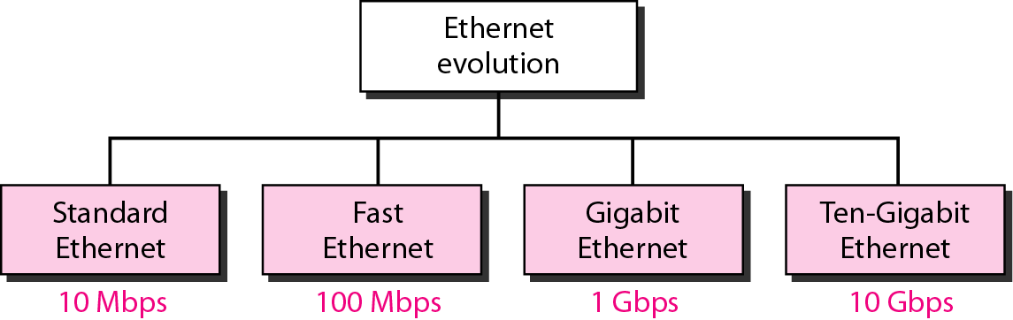
Figure: Ethernet evolution through four generations

Slide 6
1. STANDARD ETHERNET
Ethernet is the standard way to connect computers on a network over a wired connection. It provides a simple interface and for connecting multiple devices, such computers, routers, and switches.
Ethernet is commonly used in local area networks (LAN), metropolitan area networks (MAN) and wide area networks (WAN).
It was commercially introduced in 1980 and first standardized in 1983 as IEEE 802.3.
A standard Ethernet network can transmit data at a rate up to 10 Megabits per second (10 Mbps).
Topics discussed in this section:
MAC Sublayer
Physical Layer

Slide 7
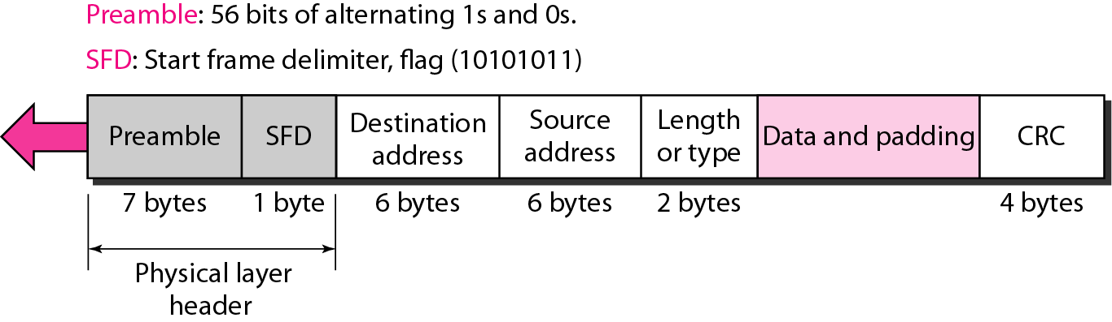
Figure: 802.3 MAC frame
Notes:
Preamble This field contains 7 bytes (56 bits) of alternating 1’s and 0’s that alert the receiving system to the coming frame and enable it to synchronize its clock if it's out of synchronization. The pattern provides only an alert and a timing pulse. The 56-bit pattern allows the stations to miss some bits at the beginning of the frame. The preamble is actually added at the physical layer and is not (formally) part of the frame.
Start frame delimiter (SFD) This field (1 byte: 10101011) signals the beginning of the frame. The SFD warns the station or stations that this is the last chance for synchronization. The last 2 bits are 11 and alerts the receiver that the next field is the destination address. This field is actually a flag that defines the beginning of the frame. We need to remember that an Ethernet frame is a variable-length frame. It needs a flag to define the beginning of the frame. The SFD field is also added at the physical layer.
Destination address (DA) This field is six bytes (48 bits) and contains the link layer address of the destination station or stations to receive the packet. When the receiver sees its own link-layer address, or a multicast address for a group that the receiver is a member of, or a broadcast address, it decapsulates the data from the frame and passes the data to the upper layer protocol defined by the value of the type field.
Source address (SA) This field is also six bytes and contains the link-layer address of the sender of the packet.
Length or type This field is defined as a type field or length field. The original Ethernet used this field as the type field to define the upper-layer protocol whose packet is encapsulated in the MAC frame. This protocol can be IP, ARP, OSPF, and so on. In other words, it serves the same purpose as the protocol field in a datagram and the port number in a segment or user datagram. It is used for multiplexing and demultiplexing.
The IEEE standard used it as the length field to define the number of bytes in the data field. Both uses are common today.
Data This field carries data encapsulated from the upper-layer protocols. It is a minimum of 46 and a maximum of 1500 bytes. We discuss the reason for these minimum and maximum values
CRC The last field contains error detection information, in this case a CRC-32

Slide 8
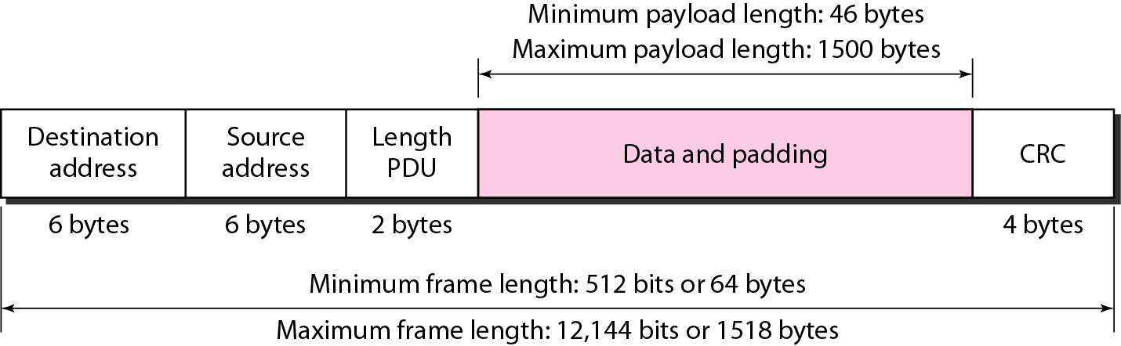
Figure: Minimum and maximum lengths
Notes:
Frame Length
Ethernet has imposed restrictions on both the minimum and maximum lengths of a frame,
The minimum length restriction is required for the correct operation of CSMAlCD. An Ethernet frame needs to have a minimum length of 512 bits or 64 bytes. Part of this length is the header and the trailer. If we count 18 bytes of header and trailer (6 bytes of source address, 6 bytes of destination address, 2 bytes of length or type, and 4 bytes of CRC), then the minimum length of data from the upper layer is 64 - 18 = 46 bytes. If the upper-layer packet is less than 46 bytes, padding is added to make up the difference.
The standard defines the maximum length of a frame (without preamble and SFD field) as 1518 bytes. If we subtract the 18 bytes of header and trailer, the maximum length of the payload is 1500 bytes. The maximum length restriction has two historical reasons. First, memory was very expensive when Ethernet was designed: a maximum length restriction helped to reduce the size of the buffer. Second, the maximum length restriction prevents one station from monopolizing the shared medium, blocking other stations that have data to send.
Frame length:
Minimum: 64 bytes (512 bits) Maximum: 1518 bytes (12,144 bits)

Slide 9

Note
Frame length:
Minimum: 64 bytes (512 bits)
Maximum: 1518 bytes (12,144 bits)

Slide 10
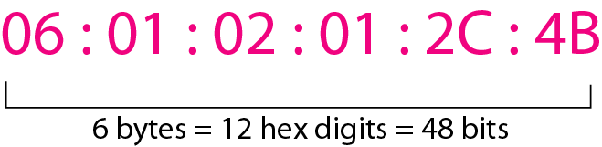
Figure: Example of an Ethernet address in hexadecimal notation
Notes:
Addressing
Each station on an Ethernet network (such as a PC, workstation, or printer) has its own network interface card (NIC). The NIC fits inside the station and provides the station with a 6-byte physical address. As shown in Figure, the Ethernet address is 6 bytes (48 bits), normally written in hexadecimal notation, with a colon between the bytes.

Slide 11
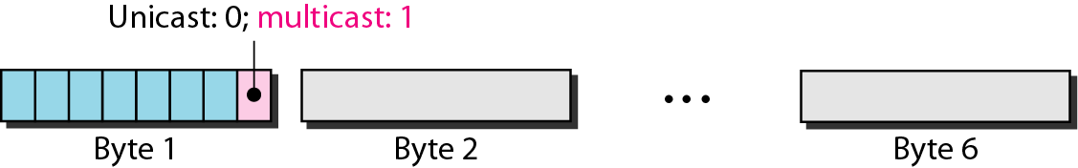
Figure: Unicast and multicast addresses
Notes:
Unicast, Multicast, and Broadcast Addresses A source address is always a unicast address-the frame comes from only one station. The destination address, however, can be unicast, multicast, or broadcast. Figure shows how to distinguish a unicast address from a multicast address. If the least significant bit of the first byte in a destination address is 0, the address is unicast; otherwise, it is multicast.
A unicast destination address defines only one recipient; the relationship between the sender and the receiver is one-to-one. A multicast destination address defines a group of addresses; the relationship between the sender and the receivers is one-to-many. The broadcast address is a special case of the multicast address; the recipients are all the stations on the LAN. A broadcast destination address is forty-eight 1s.

Slide 12
Note
The least significant bit of the first byte
defines the type of address.
If the bit is 0, the address is unicast;
otherwise, it is multicast.

Slide 13
Note
The broadcast destination address is a special case of the multicast address in which all bits are 1s.

Slide 14
Example 4.1
Define the type of the following destination addresses:
a. 4A:30:10:21:10:1A b. 47:20:1B:2E:08:EE
c. FF:FF:FF:FF:FF:FF
Solution
To find the type of the address, we need to look at the second hexadecimal digit from the left. If it is even, the address is unicast. If it is odd, the address is multicast. If all digits are F’s, the address is broadcast. Therefore, we have the following:
a. This is a unicast address because A in binary is 1010.
b. This is a multicast address because 7 in binary is 0111.
c. This is a broadcast address because all digits are F’s.
Notes:
In a unicast transmission, all stations will receive the frame, the intended recipient keeps and handles the frame; the rest discard it.
In a multicast transmission, all stations will receive the frame, the stations that are members of the group keep and handle it; the rest discard it.
In a broadcast transmission, all stations (except the sender) will receive the frame and all stations (except the sender) keep and handle it.

Slide 15
Example 4.2
Show how the address 47:20:1B:2E:08:EE is sent out on line.
Solution
The address is sent left-to-right, byte by byte; for each byte, it is sent right-to-left, bit by bit, as shown below:
Notes:
Transmission of Address Bits
The way the addresses are sent out online is different from the way they are written in hexadecimal notation. The transmission is left to right, byte by byte; however, for each byte, the least significant bit is sent first and the most significant bit is sent last. This means that the bit that defines an address as unicast or multicast arrives first at the receiver. This helps the receiver to immediately know if the packet is unicast or multicast.

Slide 16
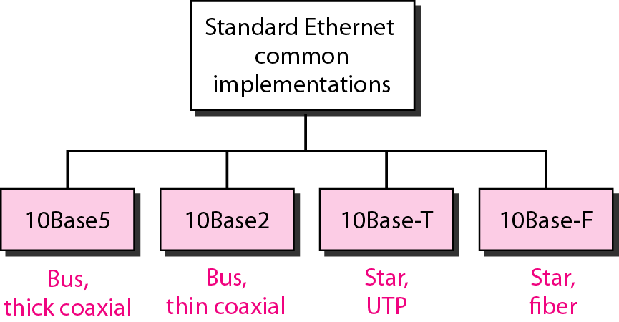
Figure: Categories of Standard Ethernet
Notes:
Implementation
The Standard Ethernet defined several implementations, but only four of them became popular during the 1980s.

Slide 17
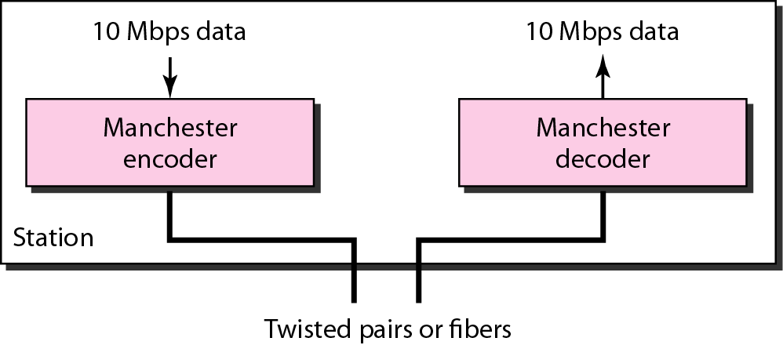
Figure: Encoding in a Standard Ethernet implementation
Notes:
Encoding and Decoding
All standard implementations use digital signaling (baseband) at 10 Mbps. At the sender, data are converted to a digital signal using the Manchester scheme; at the receiver, the received signal is interpreted as Manchester and decoded into data. Manchester encoding is self-synchronous, providing a transition at each bit interval.

Slide 18
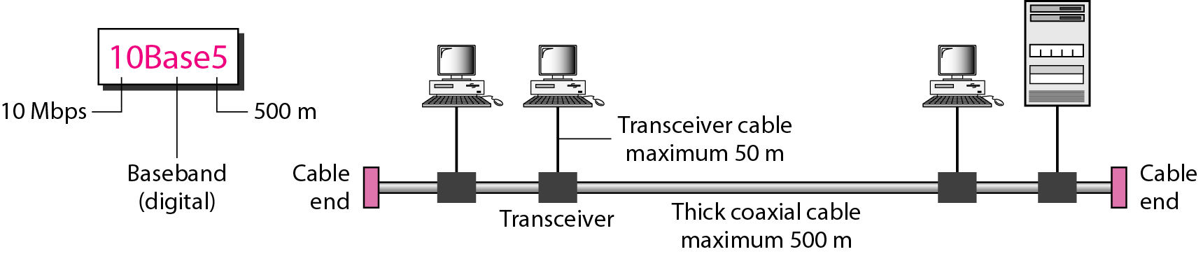
Figure: 10Base5(Thick Ethernet / Thicknet) implementation
Notes:
10Base5: Thick Ethernet
The first implementation is called 10Base5, thick Ethernet, or Thicknet. The nickname derives from the size of the cable, which is roughly the size of a garden hose and too stiff to bend with your hands. 10Base5 was the first Ethernet specification to use a bus topology with an external transceiver (transmitter/receiver) connected via a tap to a thick coaxial cable. Figure shows a schematic diagram of a 10Base5 implementation.
The transceiver is responsible for transmitting, receiving, and detecting collisions. The transceiver is connected to the station via a transceiver cable that provides separate paths for sending and receiving. This means that collision can only happen in the coaxial cable. The maximum length of the coaxial cable must not exceed 500 m, otherwise, there is excessive degradation of the signal. If a length of more than 500 m is needed, up to five segments, each a maximum of 500 meters, can be connected using repeaters.

Slide 19
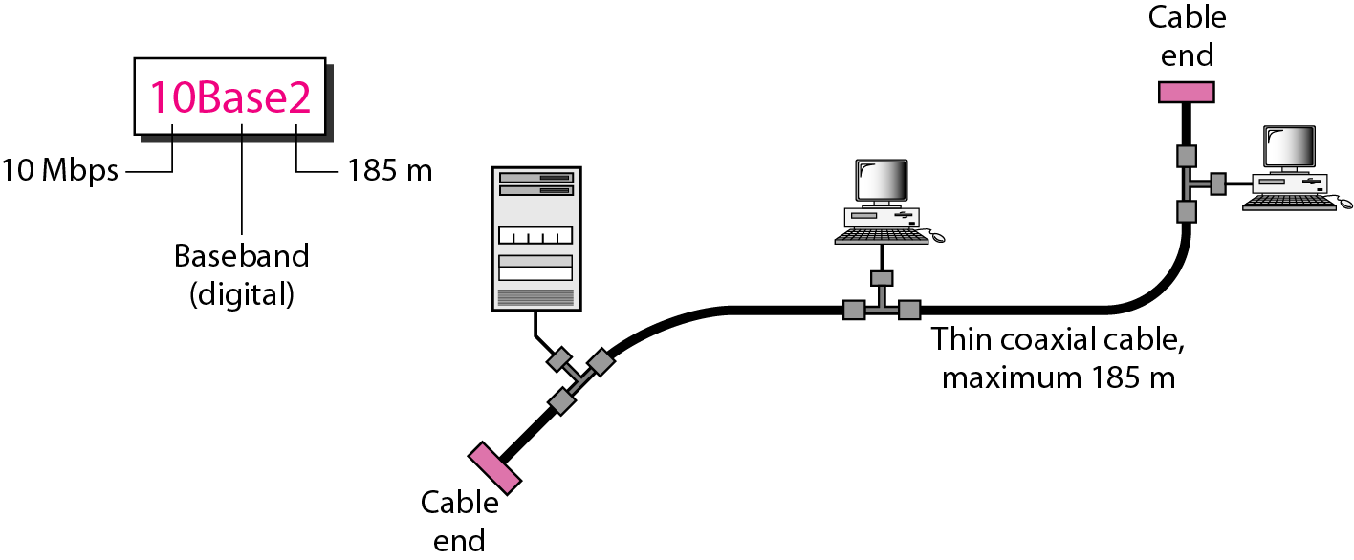
Figure: 10Base2(Thin Ethernet / Cheapernet) implementation
Notes:
10Base2: Thin Ethernet
The second implementation is called 10Base2, thin Ethernet, or Cheapernet. 10Base2 also uses a bus topology, but the cable is much thinner and more flexible. The cable can be bent to pass very close to the stations. In this case, the transceiver is normally part of the network interface card (NIC), which is installed inside the station. Figure shows the schematic diagram of a 10Base2 implementation.
Note that the collision here occurs in the thin coaxial cable. This implementation is more cost effective than 10Base5 because thin coaxial cable is less expensive than thick coaxial and the tee connections are much cheaper than taps. Installation is simpler because the thin coaxial cable is very flexible. However, the length of each segment cannot exceed 185 m (close to 200 m) due to the high level of attenuation in thin coaxial cable.

Slide 20
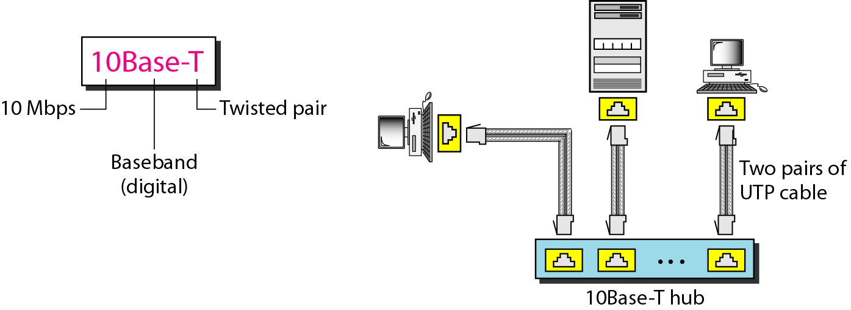
Figure: 10Base-T implementation
Notes:
10Base-T: Twisted-Pair Ethernet
The third implementation is called 1OBase- T or twisted-pair Ethernet. 1OBase-T uses a physical star topology. The stations are connected to a hub via two pairs of twisted cable, as shown in Figure.
Note that two pairs of twisted cable create two paths (one for sending and one for receiving) between the station and the hub. Any collision here happens in the hub. Compared to 10Base5 or 10Base2, we can see that the hub actually replaces the coaxial cable as far as a collision is concerned. The maximum length of the twisted cable here is defined as 100 m, to minimize the effect of attenuation in the twisted cable.

Slide 21
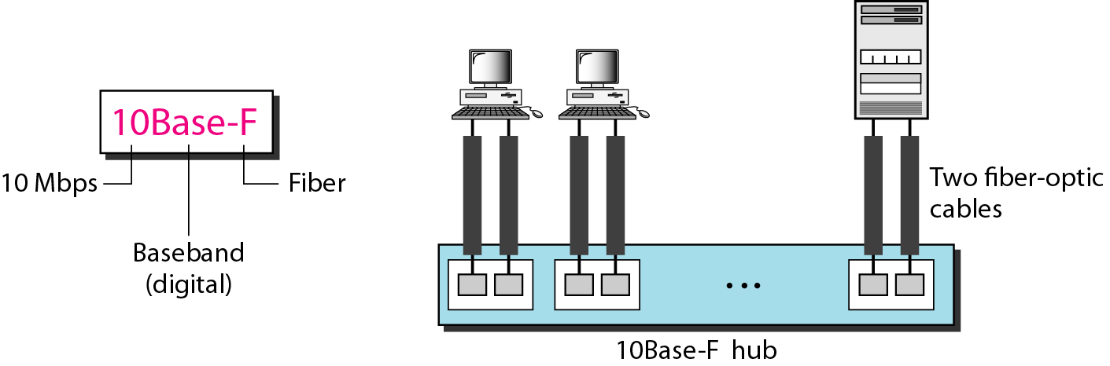
Figure: 10Base-F implementation
Notes:
10Base-F: Fiber Ethernet
Although there are several types of optical fiber 10-Mbps Ethernet, the most common is called 10Base-F. 10Base-F uses a star topology to connect stations to a hub. The stations are connected to the hub using two fiber-optic cables, as shown in Figure.

Slide 22
Table: Summary of Standard Ethernet implementations
Notes:
In the nomenclature 10BaseX, the number defines the data rate (10 Mbps), the term Base means baseband (digital) signal, and X approximately defines either the maximum size of the cable in 100 meters (for example 5 for 500 or 2 for 185 meters) or the type of cable, T for unshielded twisted pair cable (UTP) and F for fiber-optic. The standard Ethernet uses a baseband signal, which means that the bits are changed to a digital signal and directly sent on the line.

Slide 23
Token Bus (IEEE 802.4) Network
Token Bus (IEEE 802.4) is a standard for implementing token ring over the virtual ring in LANs. The physical media has a bus or a tree topology and uses coaxial cables. A virtual ring is created with the nodes/stations and the token is passed from one node to the next in a sequence along this virtual ring. Each node knows the address of its preceding station and its succeeding station. A station can only transmit data when it has the token. The working principle of the token bus is similar to Token Ring.

Slide 24
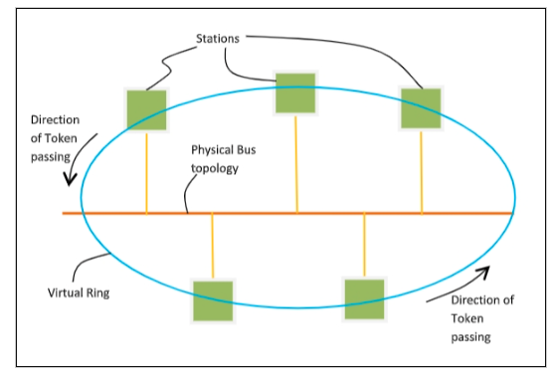
Token Passing Mechanism in Token Bus
A token is a small message that circulates among the stations of a computer network providing permission to the stations for transmission. If a station has data to transmit when it receives a token, it sends the data and then passes the token to the next station; otherwise, it simply passes the token to the next station. This is depicted in the following diagram −

Slide 25
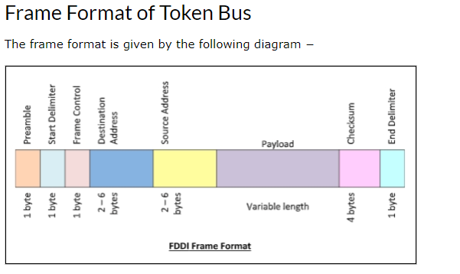

Slide 26
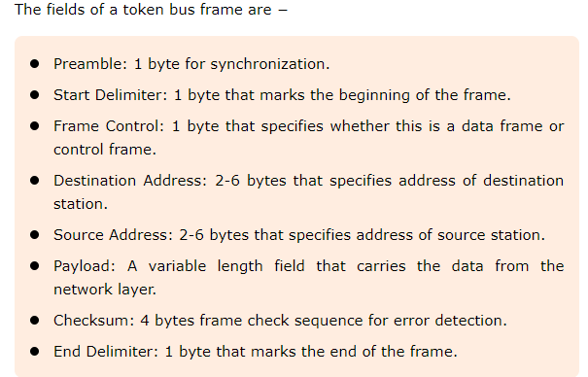

Slide 27
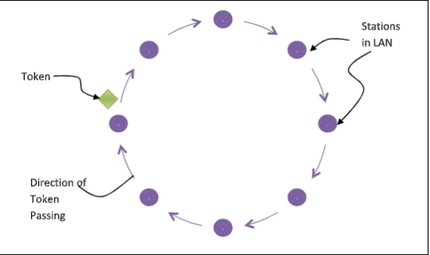
Token Ring (IEEE 802.5) Network
Token ring (IEEE 802.5) is a communication protocol in a local area network (LAN) where all stations are connected in a ring topology and pass one or more tokens for channel acquisition. A token is a special frame of 3 bytes that circulates along the ring of stations. A station can send data frames only if it holds a token. The tokens are released on successful receipt of the data frame.

Slide 28
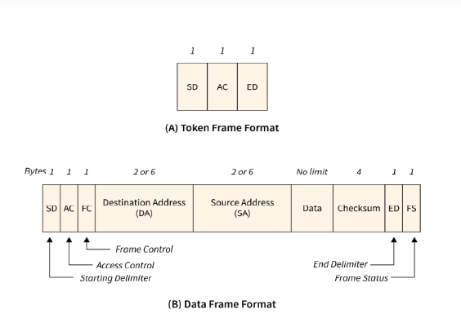

Slide 29
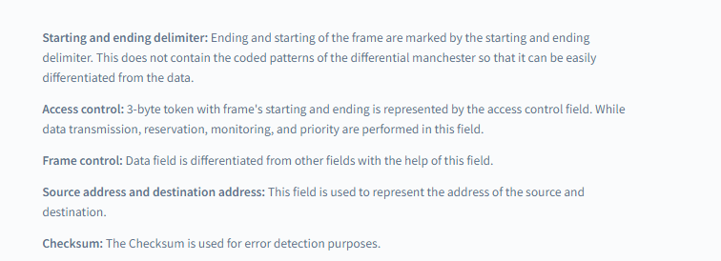

Slide 30
BLUETOOTH
Bluetooth is a wireless LAN technology designed to connect devices of different functions such as telephones, notebooks, computers, cameras, printers, coffee makers, and so on.
A Bluetooth LAN is an ad hoc network, which means that the network is formed spontaneously.
Topics discussed in this section:
Architecture
Bluetooth Layers
Base band Layer
L2CAP

Slide 31
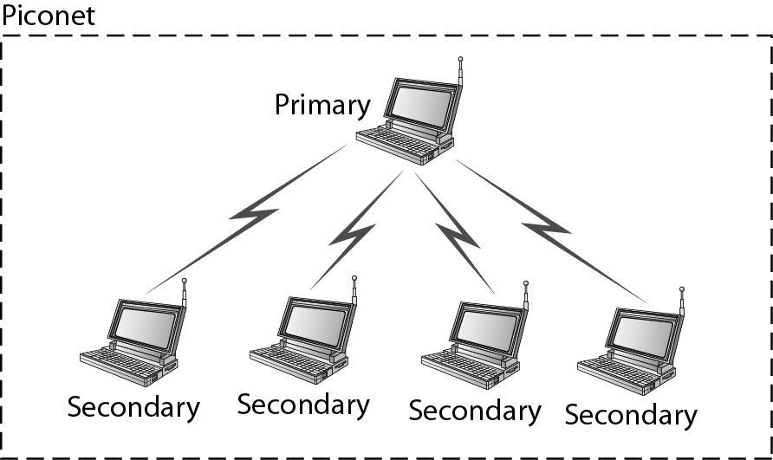
Figure: Piconet

Slide 32
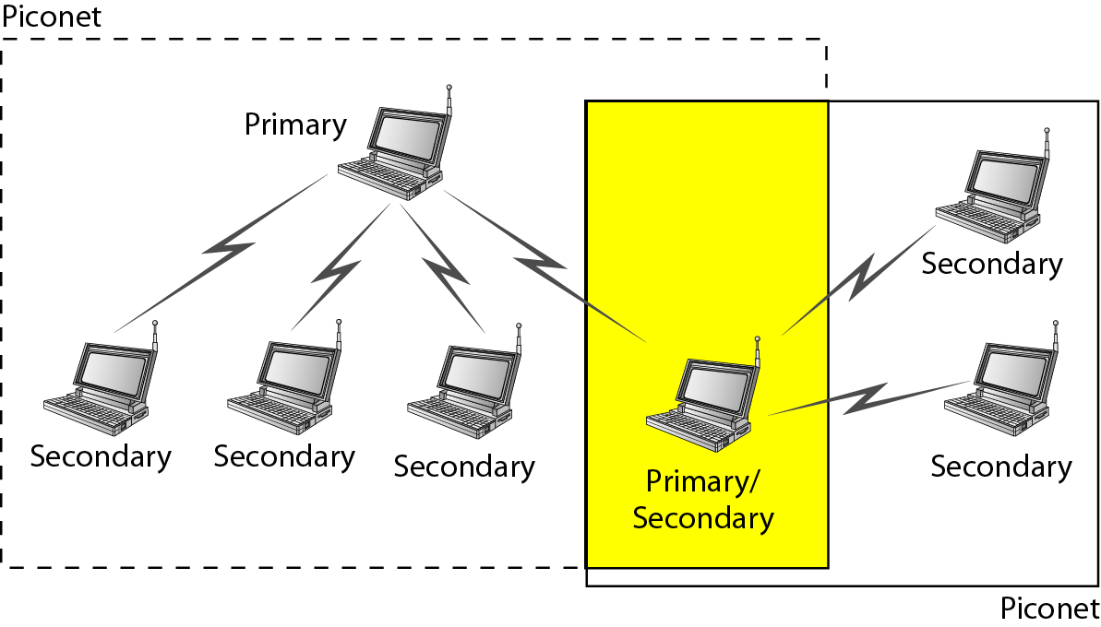
Figure: Scatternet

Slide 33
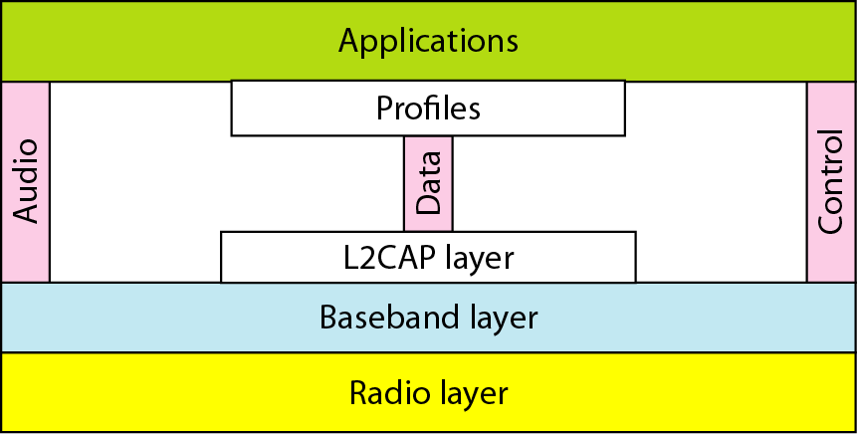
Figure: Bluetooth layers
Notes:
The Bluetooth L2CAP or logical link control and adaptation protocol is used to provide an interface for all the data applications that use the ACL links. The Bluetooth L2CAP provides multiplexing between the higher layer protocols. This enables multiple applications to utilise the same lower layer links.

Slide 34
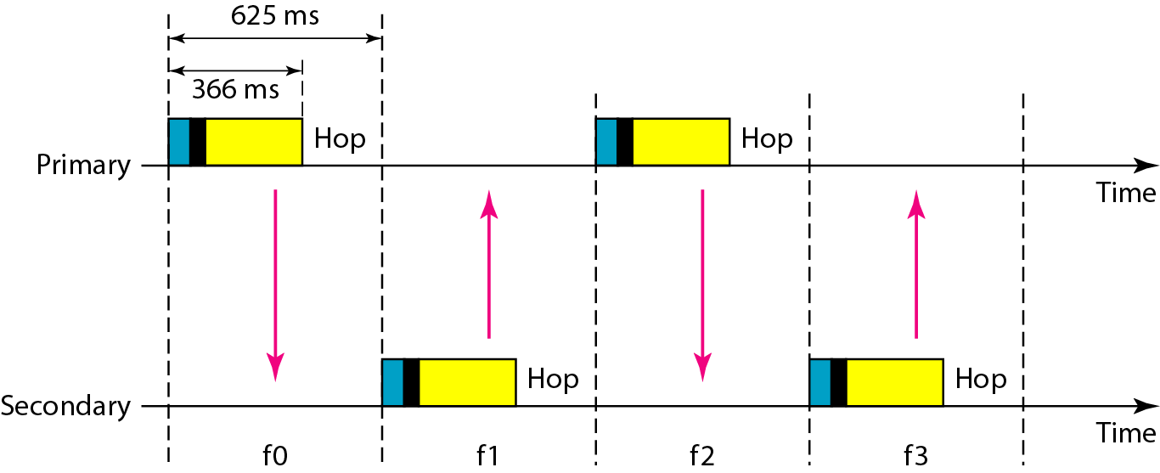
Figure: Single-secondary communication

Slide 35
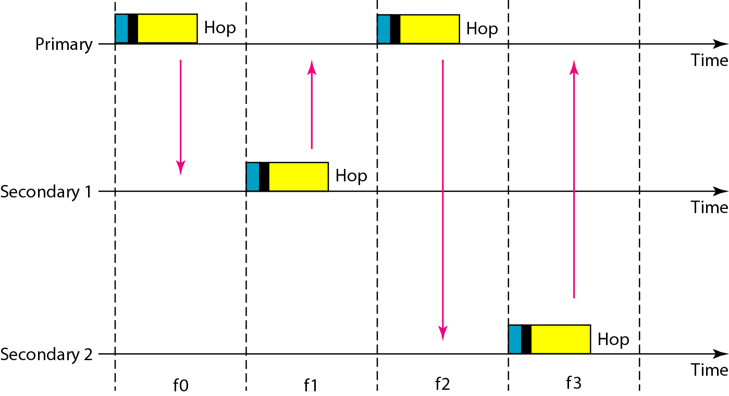
Figure: Multiple-secondary communication

Slide 36
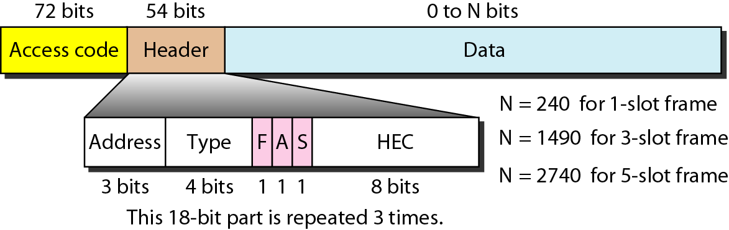
Figure: Frame format types

Slide 37
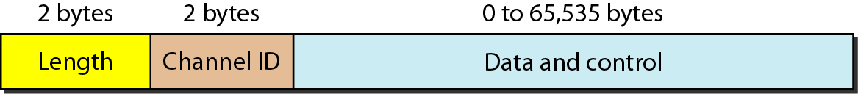
Figure: L2CAP data packet format

Slide 38
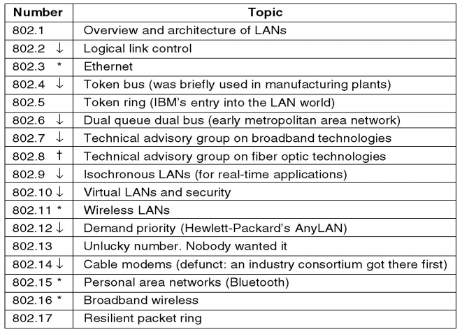
IEEE 802 Standards
The important are marked with *. The ones marked with are hibernating. The ones marked with gave up.

Slide 39
Wireless LAN IEEE 802.11
In 1990, the IEEE 802 Committee formed a new working group, IEEE 802.11, specifically devoted to wireless LANs, with a charter to develop a MAC protocol and physical medium specification.
Since that time, the demand for WLANs, at different frequencies and data rates, has exploded.
Keeping pace with this demand, the IEEE 802.11 working group has issued an ever-expanding list of standards.
IEEE has defined the specifications for a wireless LAN, called IEEE 802.11, which covers the physical and data link layers.

Slide 40
IEEE 802.11 Terminology

Slide 41
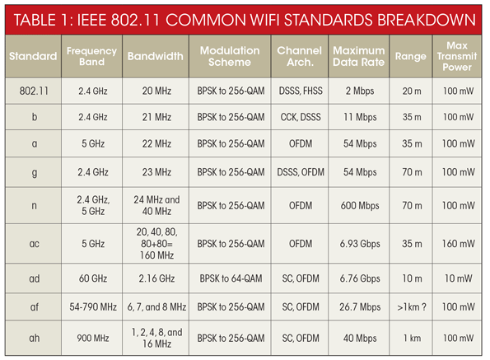
IEEE 802.11 Standards
Notes:
The Wi-Fi Alliance
The first 802.11 standard to gain broad industry acceptance was 802.11b. Although 802.11b products are all based on the same standard, there is always a concern whether products from different vendors will successfully interoperate. To meet this concern, the Wireless Ethernet Compatibility Alliance (WECA), an industry consortium, was formed in 1999. This organization, subsequently renamed the Wi-Fi (Wireless Fidelity) Alliance, created a test suite to certify interoperability for 802.11b products. The term used for certified 802.11b products is Wi-Fi. Wi-Fi certification has been extended to 802.11g products,. The Wi-Fi Alliance has also developed a certification process for 802.11a products, called Wi-Fi5. The Wi-Fi Alliance is concerned with a range of market areas for WLANs, including enterprise, home, and hot spots.

Slide 42
Topics discussed in this section:
Architecture
MAC Sublayer
Physical Layer

Slide 43
1. ARCHITECTURE
The standard defines two kinds of services:
  Basic Service Set (BSS)
  Extended Service Set (ESS)

Slide 44
i). Basic Service Set (BSS)
IEEE 802.11 defines the BSS as the building block of a wireless LAN.
A BSS is made of stationary or mobile wireless stations and an optional central base station, known as the access point (AP).
BSS network categories
  Ad-hoc network
  Infrastructure network
Notes:
The BSS without an AP is a stand-alone network and cannot send data to other BSSs. It is called an ad hoc architecture. In this architecture, stations can form a network without the need of an AP; they can locate one another and agree to be part of a BSS.
An ad hoc network is a peer-to-peer network (no centralized server) set up temporarily to meet some immediate need. For example, a group of employees, each with a laptop or palmtop computer, may convene in a conference room for a business or classroom meeting. The employees link their computers in a temporary network just for the duration of the meeting.
A BSS with an AP is sometimes referred to as an infrastructure network.

Slide 45
Note
A BSS without an AP is called an ad hoc network;
a BSS with an AP is called an infrastructure network.

Slide 46
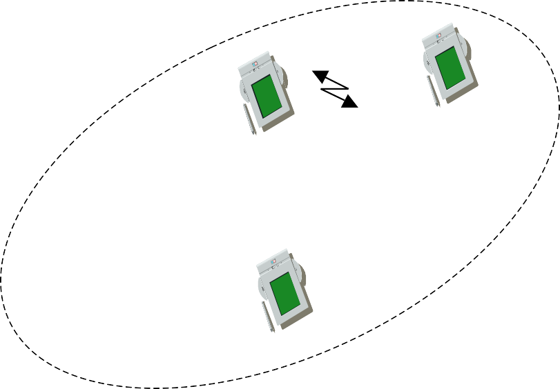






























Figure: Basic Service Sets (BSSs)
infrastructure network
AP
AP: Access Point
AP
wired network
AP
ad-hoc network

Slide 47
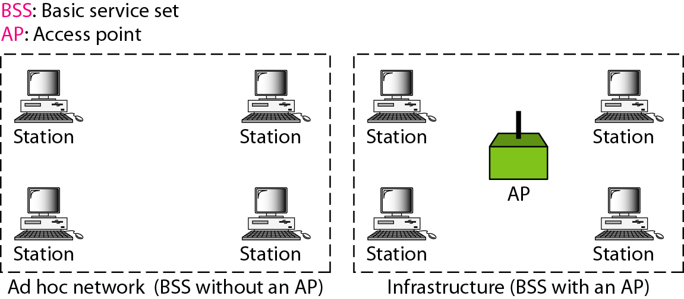
Figure: Basic Service Sets (BSSs)
Notes:
The BSS without an AP is a stand-alone network and cannot send data to other BSSs. It is called an ad hoc architecture. In this architecture, stations can form a network without the need of an AP; they can locate one another and agree to be part of a BSS.
An ad hoc network is a peer-to-peer network (no centralized server) set up temporarily to meet some immediate need. For example, a group of employees, each with a laptop or palmtop computer, may convene in a conference room for a business or classroom meeting. The employees link their computers in a temporary network just for the duration of the meeting.
A BSS with an AP is sometimes referred to as an infrastructure network.

Slide 48






802.11: ad-hoc mode
802.11 LAN
Direct communication
within a limited range
Station (STA): terminal with access mechanisms to the wireless medium
Basic Service Set (BSS): group of stations in range and using the same radio frequency
STA₁
BSS₁
STA₃
STA₂
BSS₂
STA₅
STA₄
802.11 LAN

Slide 49









802.11: infrastructure mode
Station (STA)
802.11 LAN
802.x LAN
o terminal with access mechanisms to the wireless medium and radio contact to the access point
STA₁
Basic Service Set (BSS)
o group of stations using the same radio frequency
BSS
Portal
1
Access
Point
Access Point
o station integrated into the wireless LAN and the distribution system
Distribution System
ESS
Access
Point
Portal
o bridge to other (wired) networks
BSS₂
Distribution System
o interconnection network to form one logical network (EES:
Extended Service Set) based on several BSS
STA₂
802.11 LAN
STA₃

Slide 50
ii). Extended Service Set (ESS)
An ESS is made up of two or more BSSs with APs.
In this case, the BSSs are connected through a distribution system, which is usually a wired LAN. The distribution system connects the APs in the BSSs.
IEEE 802.11 does not restrict the distribution system; it can be any IEEE LAN such as an Ethernet.
The extended service set uses two types of stations:
mobile and stationary.
The mobile stations are normal stations inside a BSS.
The stationary stations are AP stations that are part of a wired LAN.

Slide 51
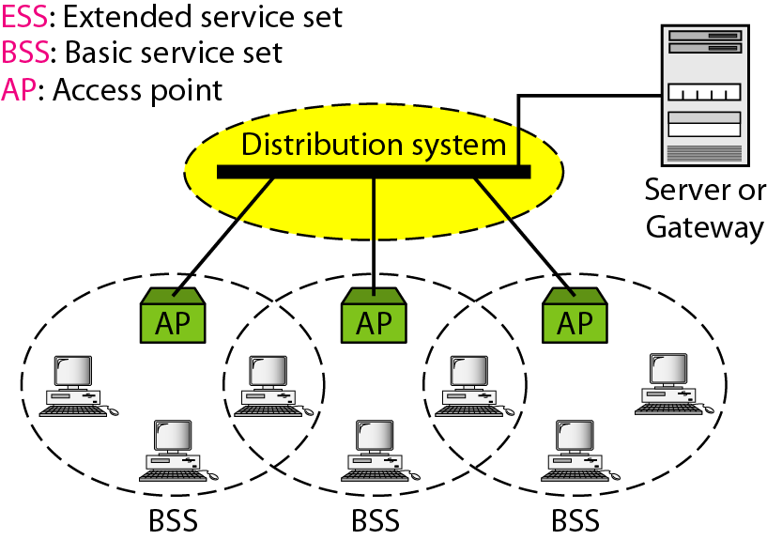
Figure: Extended Service Set (ESS)

Slide 52
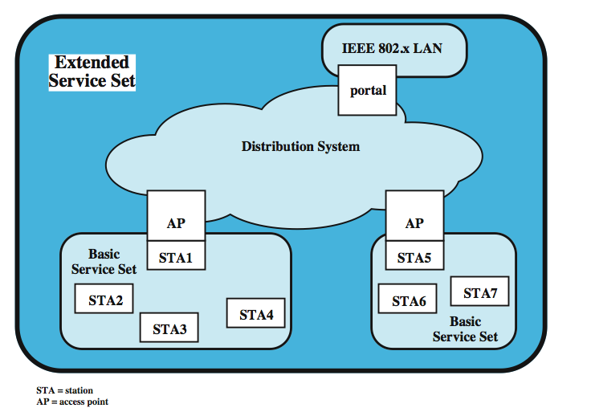
Notes:
The smallest building block of a wireless LAN is a basic service set (BSS), which consists of some number of stations executing the same MAC protocol and competing for access to the same shared wireless medium. A BSS may be isolated or it may connect to a backbone distribution system (DS) through an access point (AP).
A simple configuration is shown in above Figure, in which each station belongs to a single BSS; that is, each station is within wireless range only of other stations within the same BSS. It is also possible for two BSSs to overlap geographically, so that a single station could participate in more than one BSS. Further, the association between a station and a BSS is dynamic. Stations may turn off, come within range, and go out of range.

Slide 53


IEEE standard 802.11
fixed terminal
mobile terminal
server
infrastructure network access point
application
application
TCP
TCP
IP
IP
LLC
LLC
LLC
802.11 MAC
802.11 MAC
802.3 MAC
802.3 MAC
802.11 PHY
802.11 PHY
802.3 PHY
802.3 PHY

Slide 54
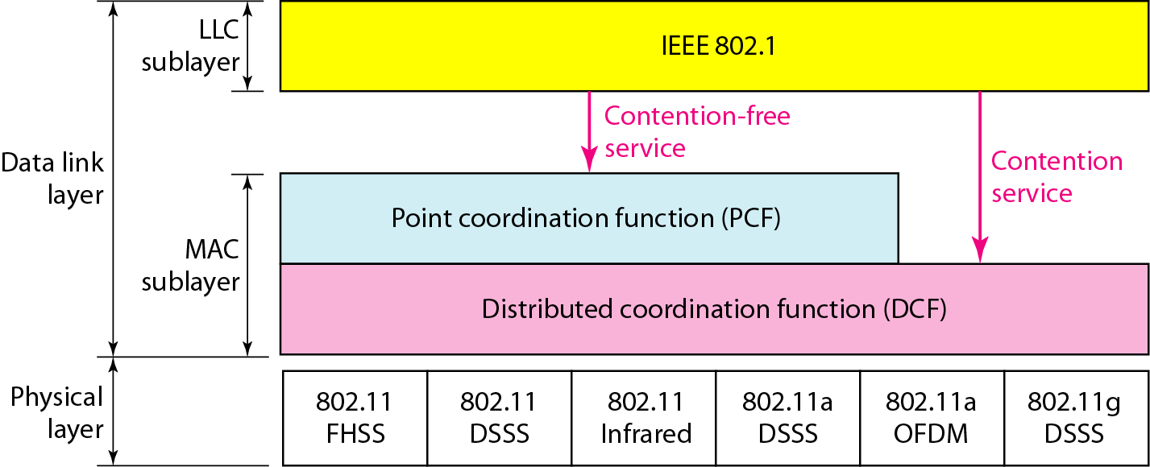
2. MAC Sublayer
Notes:
The basic services provided by MAC are the
Asynchronous data service(mandatory) -
In Asynchronous Transmission, data is sent in form of byte or character. This transmission is the half duplex type transmission. In this transmission start bits and stop bits are added with data. It does not require synchronization (where as in Synchronous Transmission, data is sent in form of blocks or frames. This transmission is the full duplex type. Between sender and receiver the synchronization is compulsory. In Synchronous transmission, There is no gap present between data. It is more efficient and more reliable than asynchronous transmission to transfer the large amount of data)
Time-bounded service(optional) –
implemented using PCF
The 802.11 working group considered two types of proposals for a MAC algorithm: distributed access protocols, which, like Ethernet, distribute the decision to transmit over all the nodes using a carrier sense mechanism; and centralized access protocols, which involve regulation of transmission by a centralized decision maker.
A distributed access protocol makes sense for an ad hoc network of peer workstations (typically an IBSS) and may also be attractive in other wireless LAN configurations that consist primarily of bursty traffic.
A centralized access protocol is natural for configurations in which a number of wireless stations are interconnected with each other and some sort of base station that attaches to a backbone wired LAN; it is especially useful if some of the data is time sensitive or high priority.
Access methods
The end result for 802.11 is a MAC algorithm called DFWMAC (distributed foundation wireless MAC) that provides a distributed access control mechanism with an optional centralized control built on top of that. The lower sub layer of the MAC layer is the distributed coordination function (DCF). DCF uses a contention algorithm to provide access to all traffic. Ordinary asynchronous traffic directly uses DCF. The point coordination function (PCF) is a centralized MAC algorithm used to provide contention-free service. PCF is built on top of DCF and exploits features of DCF to assure access for its users.
IEEE 802.11 defines two MAC sub-layers :-
Distributed Coordination Function (DCF) –
DCF uses CSMA/CA as access method as wireless LAN can’t implement CSMA/CD. It only offers asynchronous service.
Point Coordination Function (PCF) –
PCP is implemented on top of DCF and mostly used for time-service transmission. It uses a centralized, contention-free polling access method. It offers both asynchronous and time-bounded service.

Slide 55

DCF and PCF
PCF and DCF operate concurrently within the same BSS.
The two access methods alternate, with a contention-free period (CFP) followed by a contention period (CP).
DCF: fundamental access method of IEEE 802.11 MAC, implemented in all STAs.
  known as CSMA/CA
55

Slide 56
PCF
Supports time-bounded services.
Lets stations to have priority access to the wireless medium.
Polling stations one by one (centralized operation)
Coordinated by Point Coordinator (PC), typically collocated with the AP.
PCF has higher priority than the DCF.
Beacon frame is a management frame that maintains the synchronization of the timers in the stations and delivers protocol related parameters.

Slide 57
DCF MAC Requirements
To avoid interference among simultaneous transmissions
  But enable as many non-interfering transmission as possible
  Maintain fairness among transmissions
No centralized coordinators: fully distributed operations
No clock synchronization: asynchronous operations
23

Slide 58
CSMA/CA
DCF sub-layer uses CSMA/CA
  if station has frame to send it listens to medium
  if medium idle, station may transmit
  else waits until current transmission completes
No collision detection since on wireless network, so use collision avoidance (backoff and RTS/CTS)
DCF includes delays that act as a priority scheme
  DIFS: DCF inter-frame space
  SIFS: short inter-frame space (SIFS < DIFS)
58
Notes:
The DCF sublayer makes use of a simple CSMA (carrier sense multiple access) algorithm. If a station has a MAC frame to transmit, it listens to the medium. If the medium is idle, the station may transmit; otherwise the station must wait until the current transmission is complete before transmitting. The DCF does not include a collision detection function (i.e., CSMA/CD) because collision detection is not practical on a wireless network. The dynamic range of the signals on the medium is very large, so that a transmitting station cannot effectively distinguish incoming weak signals from noise and the effects of its own transmission. To ensure the smooth and fair functioning of this algorithm, DCF includes a set of delays that amounts to a priority scheme. Let us start by considering a single delay known as an interframe space (IFS). In fact, there are three different IFS values, but the algorithm is best explained by initially ignoring this detail.

Slide 59
Back-off Interval
When channel is busy, choose a back-off interval in the range [0, cw] (concept similar to non-persistent).
Count down the back-off interval when medium becomes idle.
Count down is suspended if medium becomes busy again.
When back-off interval reaches 0, transmit RTS.
Binary exponential back-off in 802.11 DCF:
  When a node fails to receive CTS, cw is doubled up (up to an upper bound).
  When a data transfer completes successfully, cw is reset to cw_{min}.
59
Notes:
cw = 2^(K-1); where K is Max no.of attempts

Slide 60
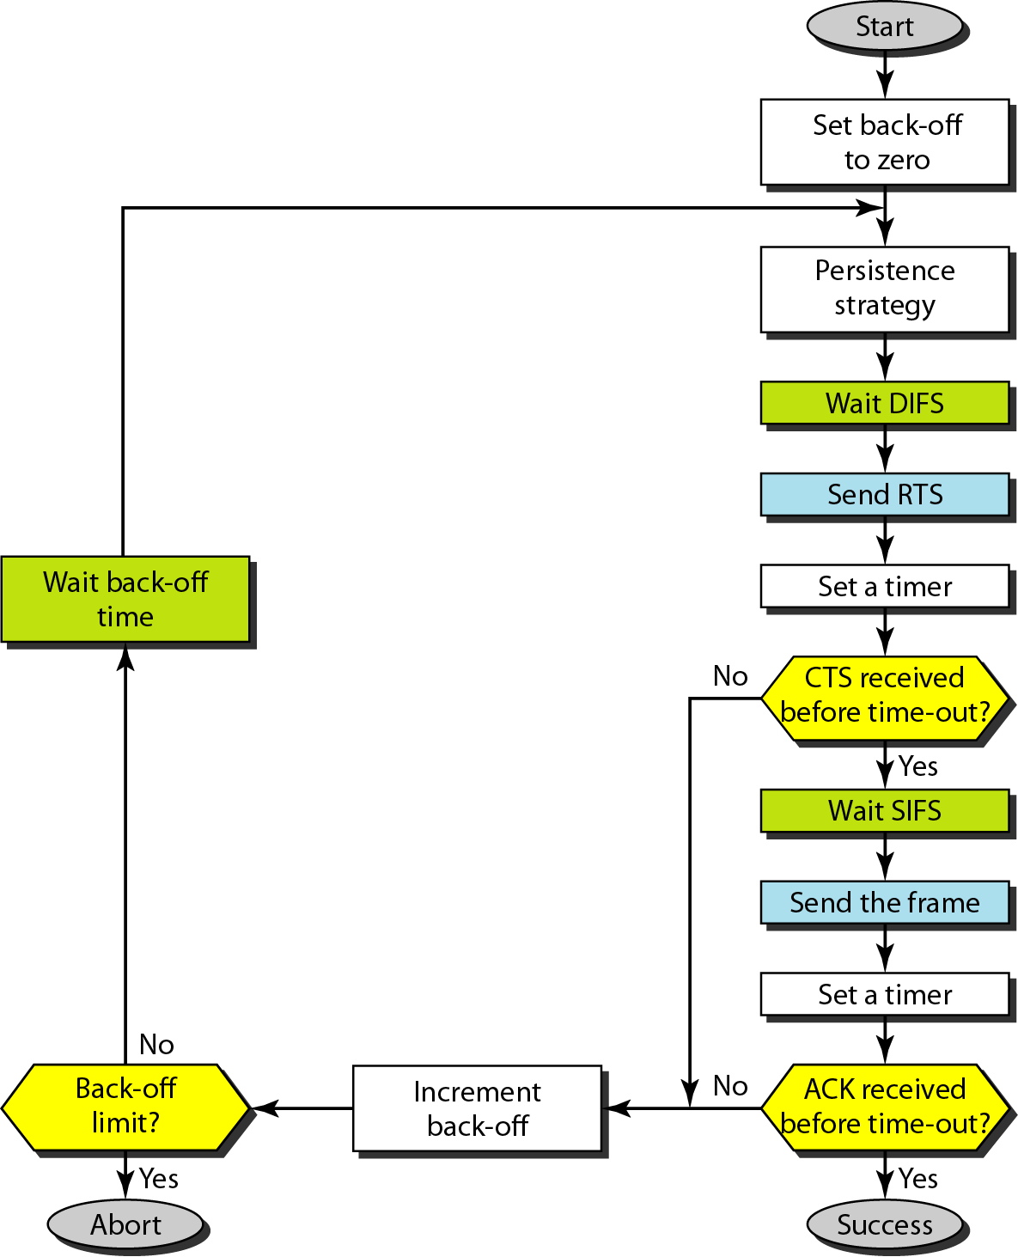
Figure: CSMA/CA flowchart

Slide 61
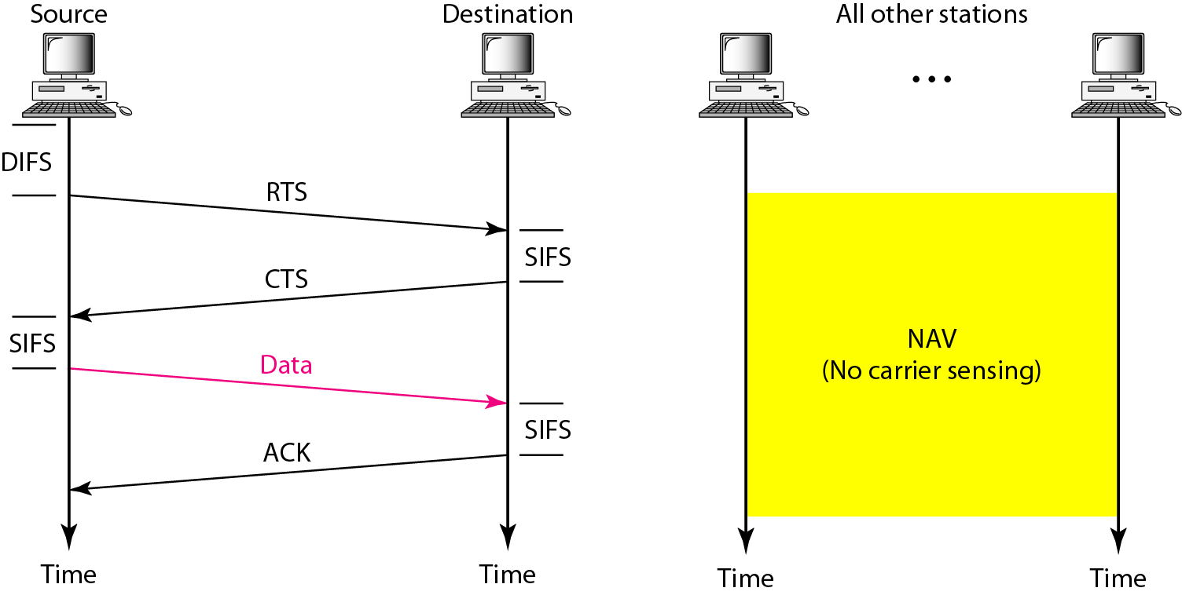
Figure: CSMA/CA and NAV

Slide 62
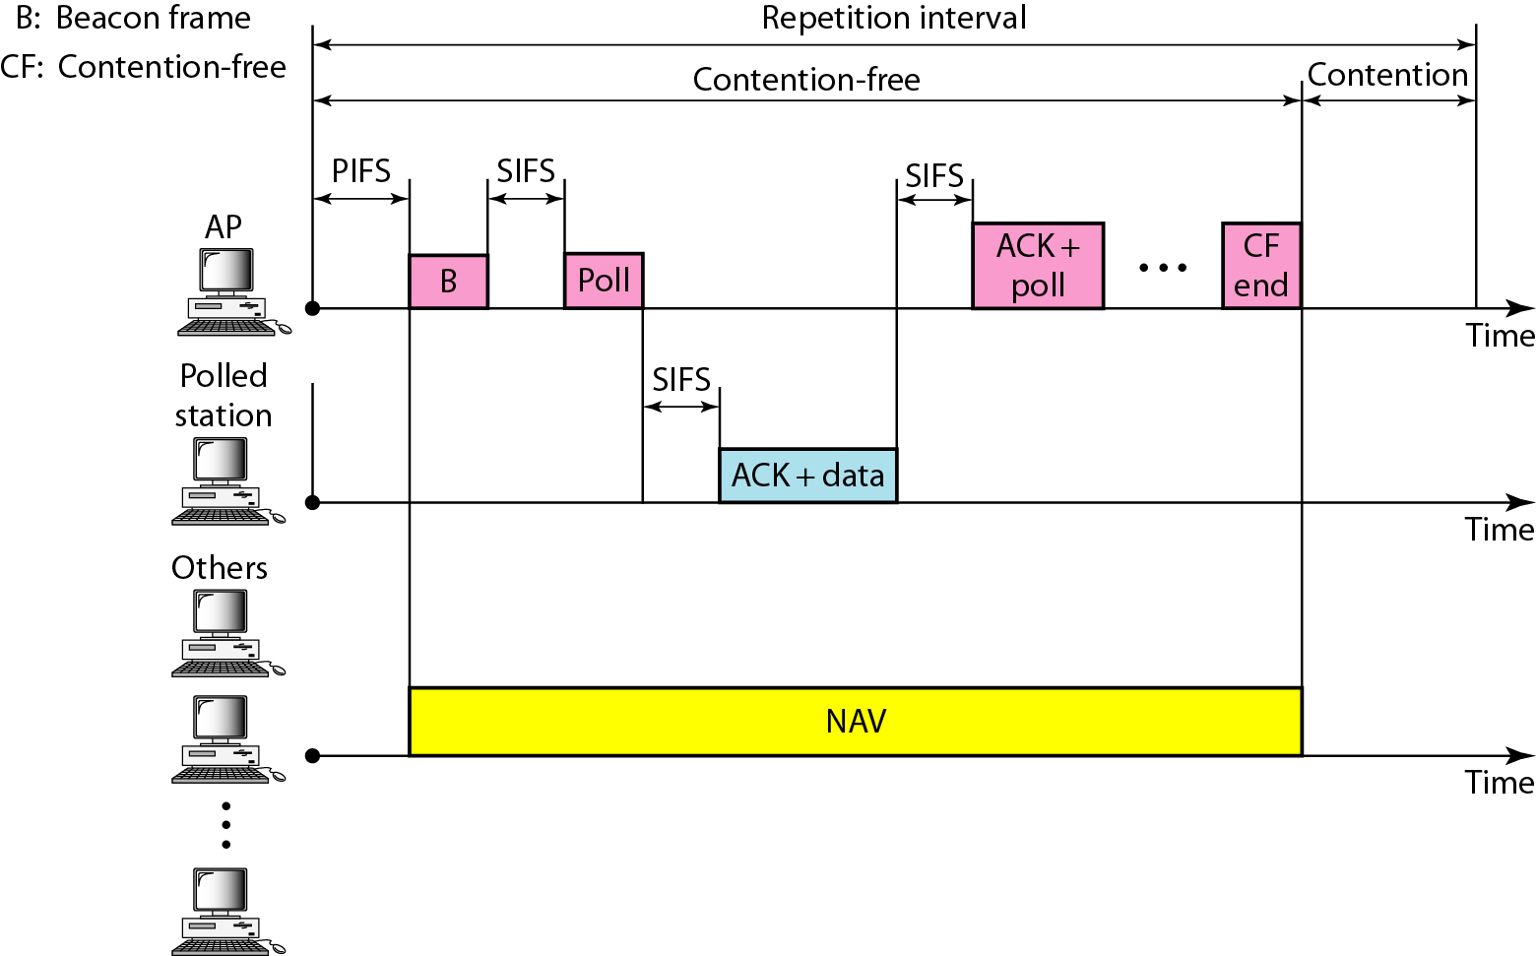
Figure: Example of repetition interval
Notes:
DIFS > PIFS > SIFS
DIFS: DCF Inter Frame Space
PIFS: PCF Inter Frame Space
SIFS: Short Inter Frame Space

Slide 63
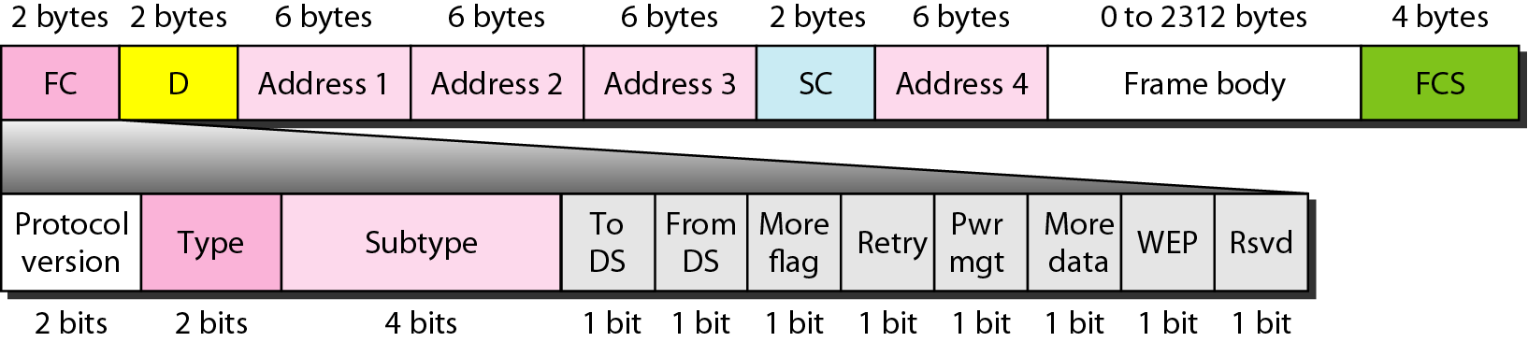
Figure: Frame format
Notes:
Frame Control(FC) –
It is 2 bytes long field which defines type of frame and some control information. Various fields present in FC are:
1. Version:
It is a 2 bit long field which indicates the current protocol version which is fixed to be 0 for now.
2. Type:
It is a 2 bit long field which determines the function of frame i.e management(00), control(01) or data(10). The value 11 is reserved.
3. Subtype:
It is a 4 bit long field which indicates sub-type of the frame like 0000 for association request, 1000 for beacon.
4. To DS:
It is a 1 bit long field which when set indicates that destination frame is for DS(distribution system).
5. From DS:
It is a 1 bit long field which when set indicates frame coming from DS.
6. More frag (More fragments):
It is 1 bit long field which when set to 1 means frame is followed by other fragments.
7. Retry:
It is 1 bit long field, if the current frame is a retransmission of an earlier frame, this bit is set to 1.
8. Power Mgmt (Power management):
It is 1 bit long field which indicates the mode of a station after successful transmission of a frame. Set to 1 the field indicates that the station goes into power-save mode. If the field is set to 0, the station stays active.
9. More data:
It is 1 bit long field which is used to indicates a receiver that a sender has more data to send than the current frame. This can be used by an access point to indicate to a station in power-save mode that more packets are buffered or it can be used by a station to indicate to an access point after being polled that more polling is necessary as the station has more data ready to transmit.
10. WEP:
It is 1 bit long field which indicates that the standard security mechanism of 802.11 is applied.
11. Order:
It is 1 bit long field, if this bit is set to 1 the received frames must be processed in strict order.
D: Duration
SC: Sequence Control

Slide 64
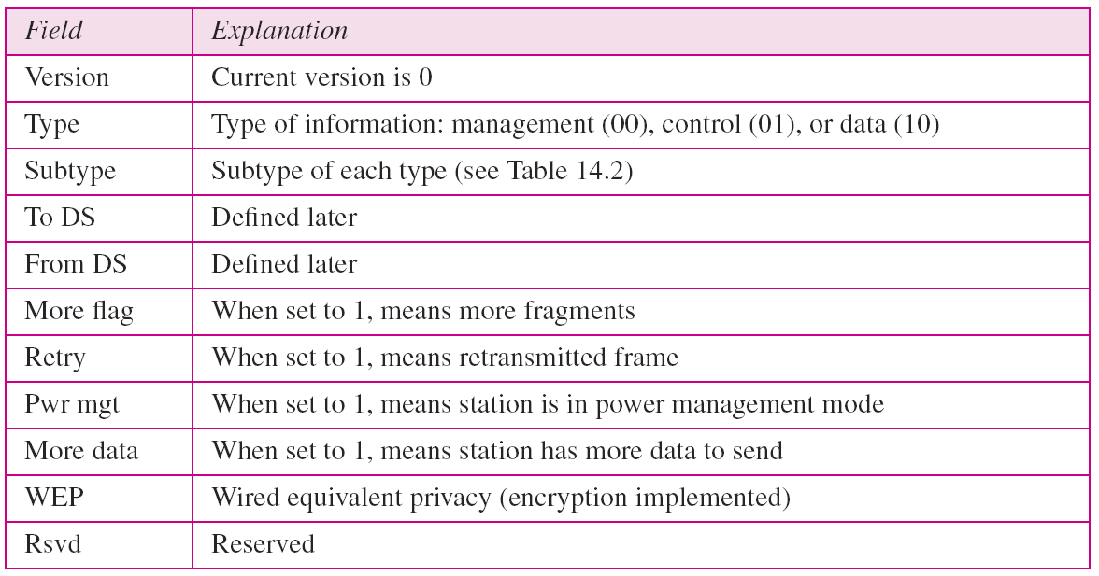
Table: Subfields in FC field

Slide 65
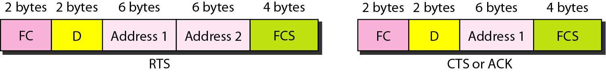
Figure: Control frames
Notes:
D: Duration

Slide 66
Table: Values of subfields in control frames

Slide 67
Table: Addresses

Slide 68
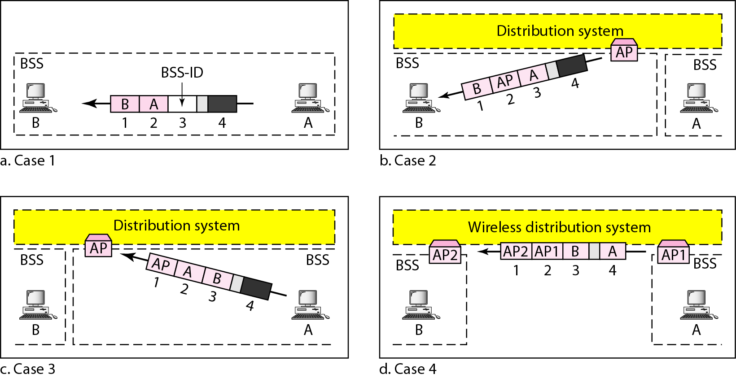
Figure: Addressing mechanisms

Slide 69
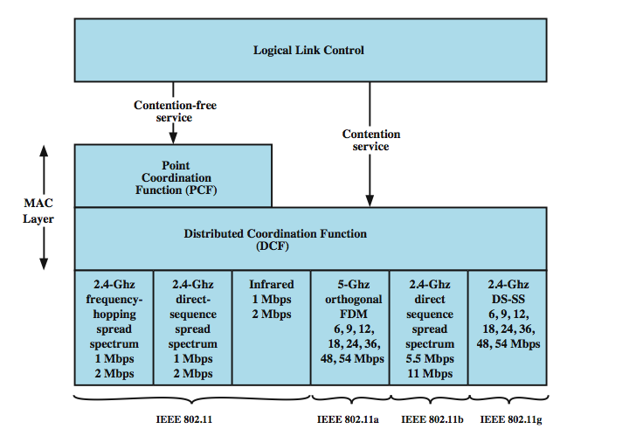
Figure: MAC layers in IEEE 802.11 standard

Slide 70
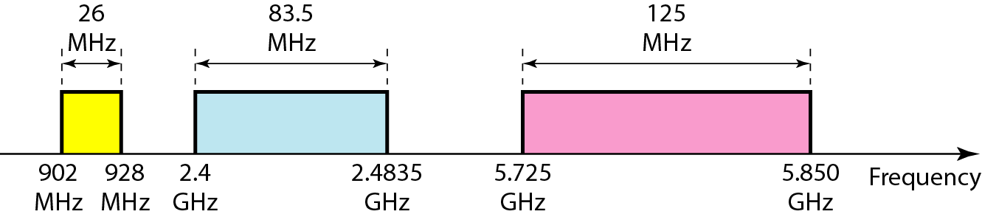
Figure: Industrial, scientific, and medical (ISM) band

Slide 71
3. Physical Layer
• 2 radio ranges (2.4 GHz and 5 GHz), 1 IR
– data rates ranging from 1 Mbps to 54 Mbps
IEEE 802.11
  2.4 GHz band frequency hopping spread spectrum (FHSS)
  2.4 GHz band direct sequence spread spectrum (DSSS)
  Baseband infrared
IEEE 802.11a
IEEE 802.11b
IEEE 802.11g

Slide 72
2.4GHz band FHSS
– Frequency changed within a specified band in a pseudo-random fashion, known only to transmitters and receivers
– Uses a pseudorandom number generator to produce the sequence of frequencies hopped to
– min. 2.5 frequency hops/s (USA), two-level GFSK modulation
– Uses 79 channels, each 1 MHz wide, starting at the low end of the 2.4 GHz band
– If all stations use same seed to the generator and stay synchronized in time => they will hop to same frequencies simultaneously
– The time interval spent at each frequency: dwell time
• Adjustable parameter, but < 400 ms
– Intruder not knowing the hopping sequence & dwell time cannot eavesdrop on transmissions
Notes:
Gaussian frequency shift keying (GFSK) is a modulation method for digital communication found in many standards such as Bluetooth, DECT and Wavenis. ... If one applies Gaussian filtering to the square-wave signal that would shift the carrier frequency, one gets GFSK.
dwell time (usually uncountable, plural dwell times) (chiefly engineering) The period of time that a system or element of a system remains in a given state.

Slide 73
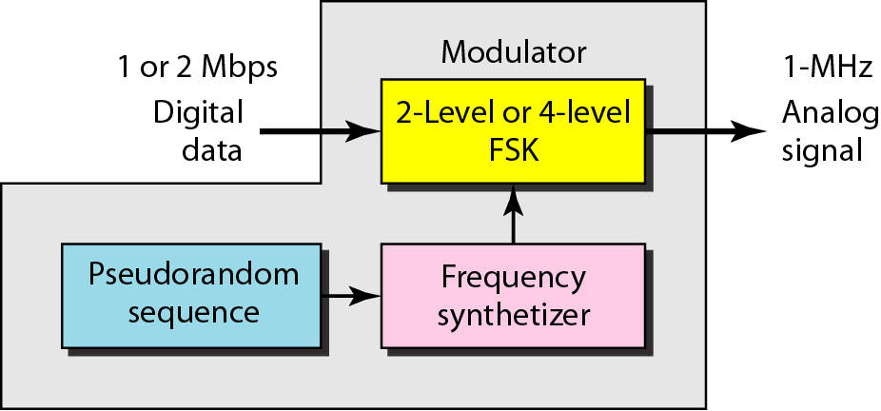
Figure: Physical layer of IEEE 802.11 FHSS

Slide 74
2.4GHz band DSSS
– A spreading code is used to spread and despread the transferred data
– Each wireless station has its own spreading code
– DBPSK or DQPSK modulation (Differential Binary Phase Shift Keying or Differential Quadrature PSK)
– Chipping sequence: +1, -1, +1, +1, -1, +1, +1, +1, -1, -1, -1 (Barker code)

Slide 75
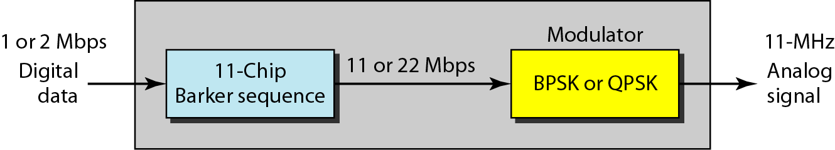
Figure: Physical layer of IEEE 802.11 DSSS

Slide 76
Baseband Infrared
– Infrared technique (for remote controls of TV sets)
– 850-950 nm, diffuse light, typically 10 m range
– Data rates 1-2 Mbps
– Infrared signals cannot penetrate walls, so cells in different rooms
are well isolated from each other

Slide 77
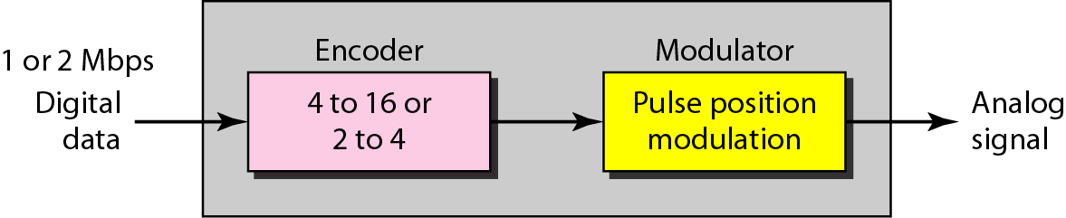
Figure: Physical layer of IEEE 802.11 infrared

Slide 78
IEEE 802.11 a, b, g
IEEE 802.11a
o Makes use of 5-GHz band
o Provides rates of 6, 9 , 12, 18, 24, 36, 48, 54 Mbps
o Uses orthogonal frequency division multiplexing (OFDM)
o Sub-carrier modulated using BPSK, QPSK, 16-QAM or 64QAM
IEEE 802.11b
o Provides data rates of 5.5 and 11 Mbps
o DSSS and complementary code keying (CCK) modulation
IEEE 802.11g
o Extends data rates to up to 54 Mbps
o Uses OFDM, in the 2.4 GHz band

Slide 79
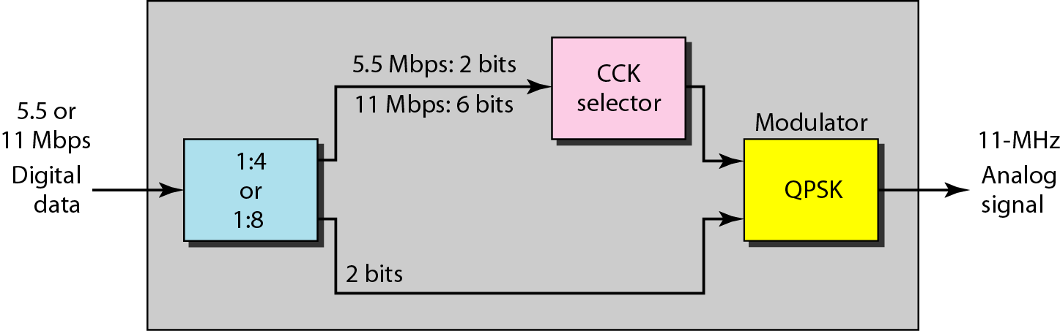
Figure: Physical layer of IEEE 802.11b

Slide 80
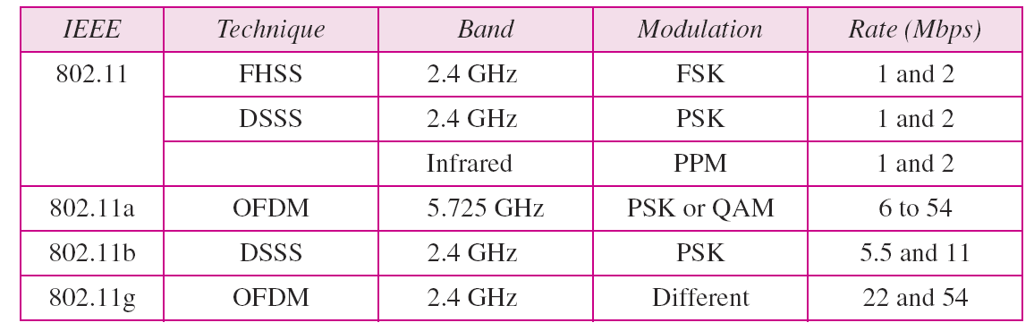
Table: Physical layers

